Slide 1


SYNOPSIS
Presented by Group-20

Slide 2

EXTREME FITNESS
Gym Management System
INTRODUCTION
Gym Management System developed using PHP is an excellent solution for gyms with a large/growing number of members, or fitness freaks. With its user-friendly interface it simplifies tasks such as signing up new members, handling payments, tracking attendance, managing trainers, and renewal of membership. In addition, it also offers video tutorials to the members in the absence of trainers about the workout plans and usage of gym equipment’s. The project aims to make gym management easier, save time and resources, and provide a better experience for both gym owners and members.
F
I
T
N
E
S
S

Slide 3
OBJECTIVE
The main objective of the project is to develop software that facilitates the data storage, data maintenance and its retrieval for the gym in an igneous way.
To store the record of the user, the trainer. Also privileges to access, modify and delete any record are with the Admin.
Only the Admin has the privilege to access any database and make the required changes, if necessary.
To develop easy-to-use software which handles the trainer-user relationship in an effective manner.
To develop a user-friendly system that requires minimal user training. Most of features and function are similar to those on any windows platform.

Slide 4
PROJECT CATEGORY
WEB APPLICATION
LANGUAGE AND SOFTWARE TOOLS USED
Front-End
HTML: HTML or Hypertext Markup Language is markup language for the web, that defines the structure of web pages. It is one of the basic building blocks of every website, so it’s crucial to learn if you want to have a career in web development.
CSS: Cascading style sheets, fondly referred to as CSS, is simply designed language intended to simply the process of making web pages presentable. CSS allows you to apply styles to web pages. It describes how a webpage should look: It prescribes colours, fonts, spacing and much more.
Java Script: It is programming language that confirms to the ECMA script standard and has first class functions. It is mainly used for creating dynamic, interactive and multimedia webpages, but can also run in non-browser environments.

Slide 5
Bootstrap: Bootstrap is a free, open-source front-end development framework for creation of websites and web apps. Designed to enable responsive development of mobile-first websites. It contains HTML CSS, JavaScript based design template for typography, forms, buttons, navigations, and other interface components.
Php: is a recursive acronym for "PHP: Hypertext Preprocessor". PHP is a server-side scripting language that is embedded in HTML. It is used to manage dynamic content and databases
Back-End:
MySQL(database): MySQL is an open-source relational database management system. Like other relational database MySQL stores data in table made up of rows and columns. User can define, manipulate, control and query data using structured Query language more commonly known as SQL

Slide 6
SOFTWARE REQUIREMENT
Front End: Chrome or Any web browser
Xampp x64 bit
Back End: Visual Studio Code or any Text Editor
HARDWARE REQUIREMENT
Processor- Intel core i3
RAM- 8 GB
Hard Disk- 500GB or more

Slide 7
MODULES
User Module:
Registration: One-time Registration is required with email verification.
Login: After registration, the user can log in and apply for the membership package.
Membership Package: After the user logs himself in, user/member is asked to choose a membership package from a list of plans.
Payment: After choosing the package, Payment form will be available where user can make card payments with validating the card details.
Payment report: After payment, a successful payment Receipt will be sent to the current email of the user.
Assigning Trainer: After payment, the user is able to choose trainers.
User Dashboard: In this section, User logs in to Dashboard where users can see the current membership plans.
Renewal plans: On user dashboard, there is a feature of renewal of plans after the current package ends. This page will again redirect to choosing a membership package.
Upload Videos: User is Provided video tutorials on how the equipment’s at the gym works. These short video tutorials are helpful for new users to enlighten them on how to properly use the provided machinery according to their workout plans.
User Logout: The user is given a logout option.

Slide 8
Admin Module:
Login: The admin is given login credentials to log himself into the website.
Admin Dashboard: In this section, Admin can see the overview of the system. It displays user information, trainer information, and package information.
Edit Membership package: the admin can create, delete and update the plans whenever he wishes.
Members-report: The admin receives the final gym member-reports on a excel sheet.
Attendance Report: This report lists the attendance of the members of the gym by the trainer.
Add Trainers: since the trainer has to be qualified for the position, the admin registers the trainer to the gym database where the admin can add, remove and update the trainer. Trainer salary will be assigned. Later login credentials will be given to the trainer.
Admin Logout: The admin is given a logout option.

Slide 9
Trainer Module:
Login: The admin gives login credentials to trainer to log himself into the trainer Dashboard.
Trainer Dashboard: In this section, Trainer can track the attendance status of the members through dashboard. The trainer can also look into the listings of the members trained under him.

Slide 10
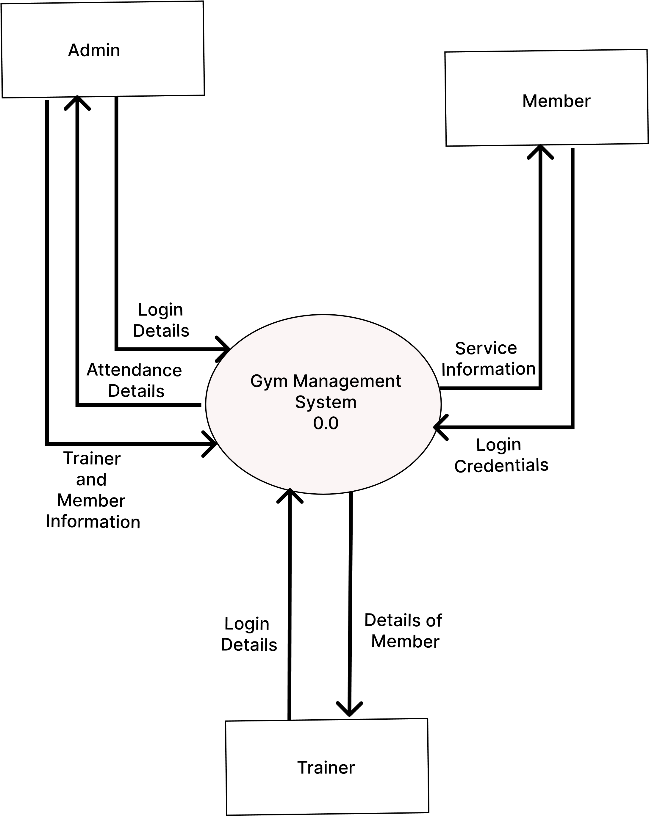
CFD(Context Flow Diagram)

Slide 11
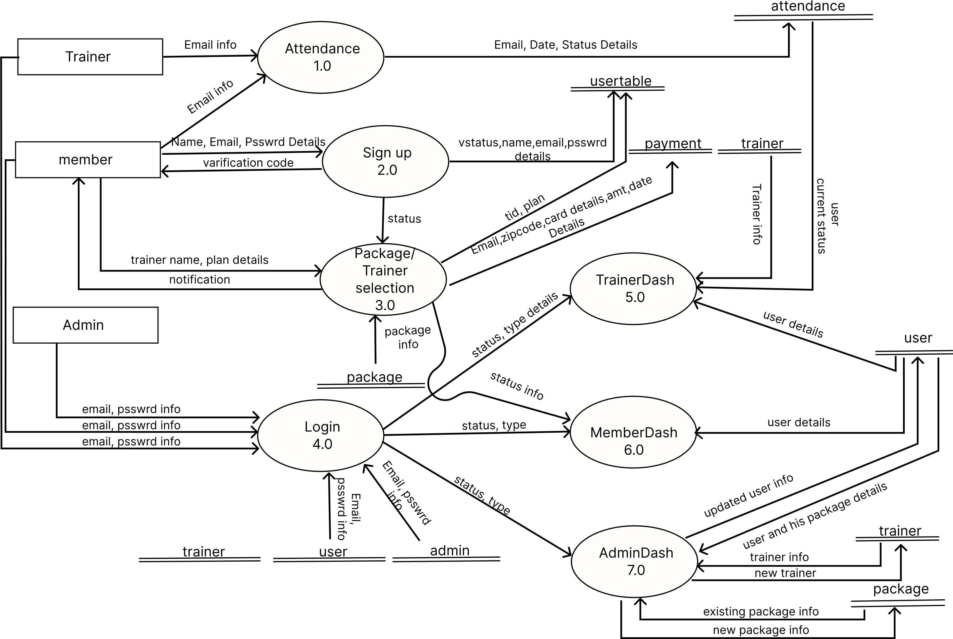
DFD(Data Flow Diagram)
Level 1 DFD
MemberDash
7.0
Email,psswrd info
AdminDash
6.0

Slide 12
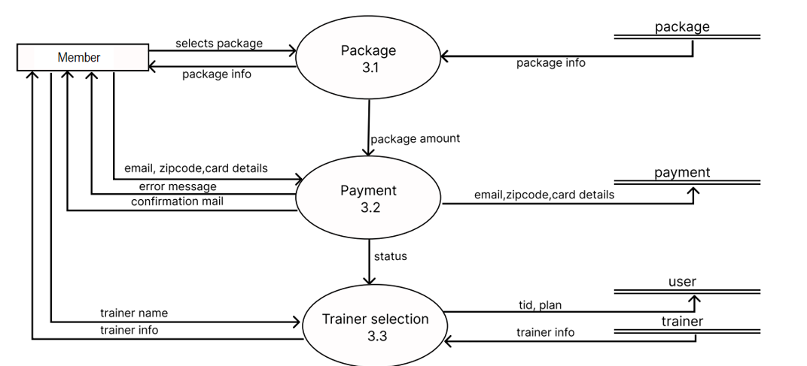
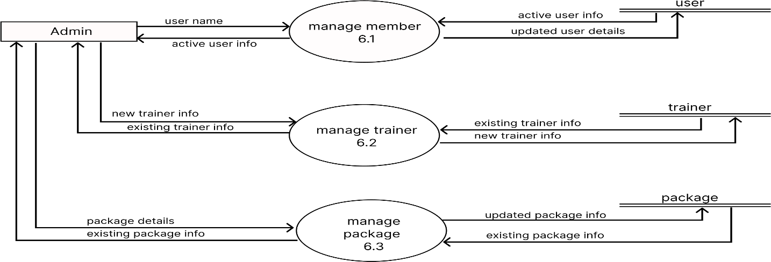
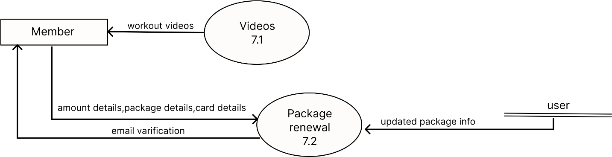
Level 2 DFD

Slide 13
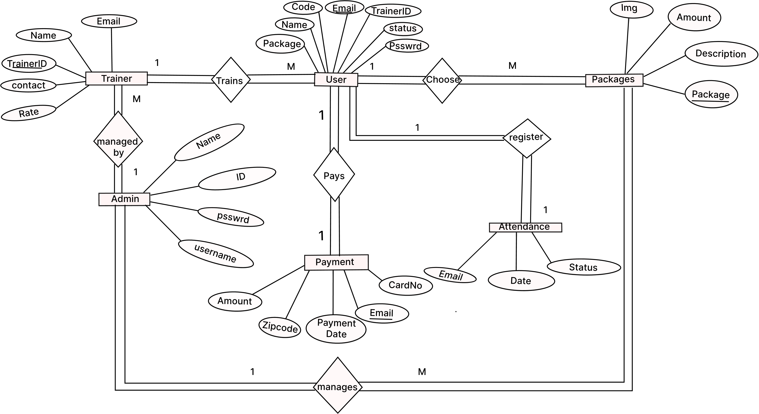
Entity Relationship Diagram(ER Diagram)

Slide 14
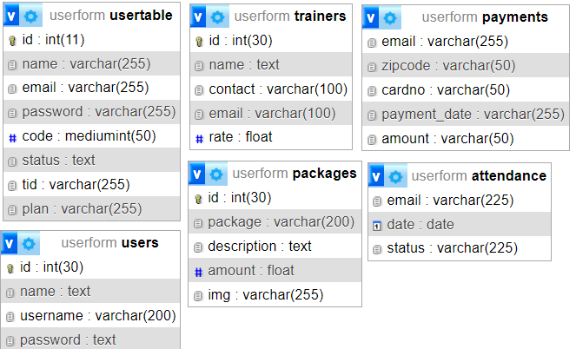
Database Design

Slide 15
LIMITATIONS
The Website does not currently support UPI payments.
Issues with internet connectivity or hardware failures could disrupt the system’s functionality.
The website does allow customization of services provided in selected packages.

Slide 16
FUTURE SCOPE
UPI payments can be implemented in the future.
Currently the website is available in only 3 selected pin code regions, new Localities can be added as per the requirements.

